Slide 1

Places Nearby
The better way enjoy your travel adventure
The Pioneers
Kalyani Nikure
Vineeth Reddy Sheri
Piyush Narhire
Yousef Almutairi

Slide 2
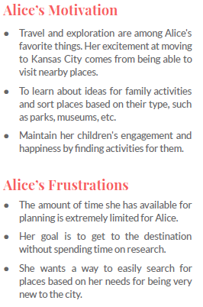

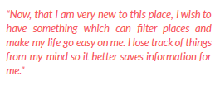
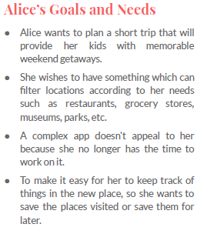
User Story

Slide 3
Project idea Places Nearby
Develop a MEAN stack web application for finding places nearby and presenting them to its users on UI
Newcomer to the place would find this application useful for exploring nearby locations and saving the places he/she wishes to visit
Save the login information of registered users as well as their favorite places in an open-source NoSQL MongoDB database
Fetch information of relevant search places from APIs such as FourSquare and Yelp

Slide 4
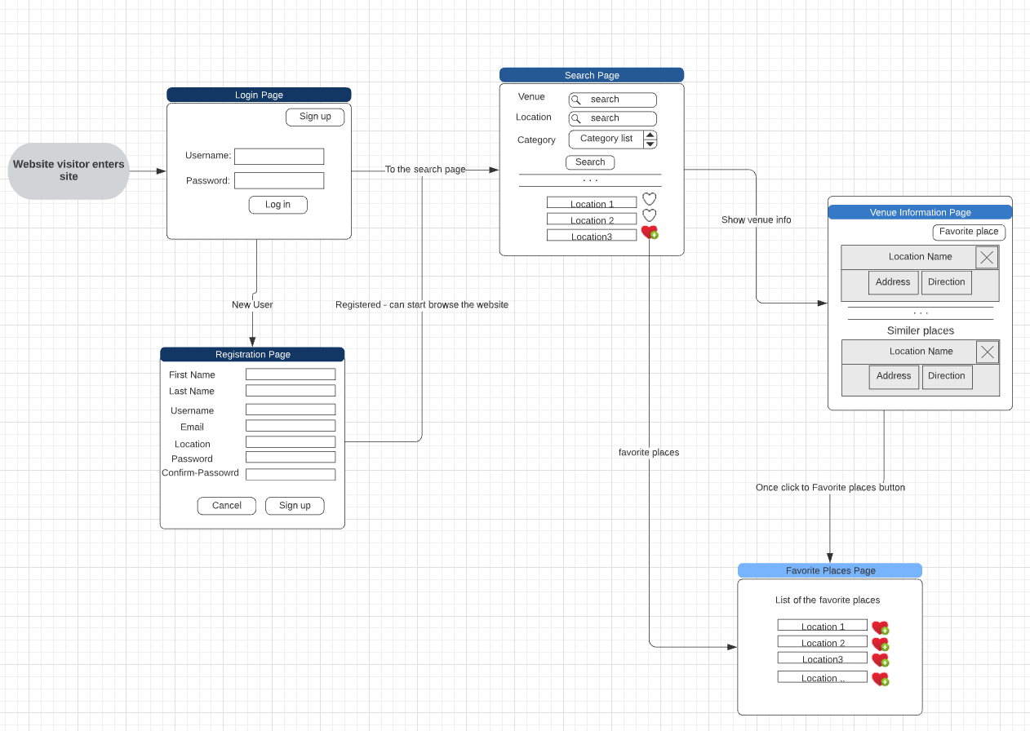
Project Workflow and Database design
Login Page
On this page, the user will be able to log in to the website using his/her username and password.
Registration Page
This page is for new users to create a new account.
Search Page
Users can search by venue name, location, and the category dropdown list to narrow the search results.
Venue Information Page
Users will get detailed information in regard to the selected venue on the previous page.
Favourite Places Page
This page will show all the favourite/saved places.

Slide 5
FourSquare Places API
Foursquare is a location-based service and it is used to find places near the users.
Has an enormous database on the places that are related to different categories.
Provides information like Name, Address, popularity, photos, tips, category, and a summary regarding the venue/place.
Consists of total 9 categories at top-level, 281 categories at level two, and 122 categories at level three.

Slide 6

Yelp API (Fusion)
Used to communicate between software's using data points to provide developers with their custom applications or websites
Used to find information about a particular place
Comprises information such as a company's ratings, pricing, or category
Data is organized into endpoints
Endpoints enable getting a large amount of data from a single or two requests more easily

Slide 7
Work Distribution
Back-End: Creation of the MongoDB Atlas cloud-based database, integration with the front-end
Kalyani Nikure
Yousef Almutairi
Front-End: UI design and workflows, integration of API's
Vineeth Reddy Sheri
Piyush Narhire
Documentation, Reports, and Presentation
All the team members

Slide 8

References
https://docs.mongodb.com/manual/core/data-model-design/
https://developer.foursquare.com/docs/places-api/
https://lucid.app/
https://www.reviewtrackers.com/blog/yelp-api/
https://www.yelp.com/developers/documentation/v3/get_started
https://spectralops.io/blog/yelp-api-guide/

Slide 9

Questions?

Slide 10

Thank You!

